Slide 1

CLASS PRESENTATION
Creativity & Innovation
Presentation Date : 3rd August, 2021
MEDICAL MOBILE APPLICATION
Group Members
Sandesh Subedi ‘A’
Subject Teacher
Nabin Chhetri
Bijay Shrestha
Suraj Pandey
Sandesh Giri

Slide 2

Company Introduction
MANTRA Services
ESTD. 2009
Introducing, MANTRA Okhati
A smartphone application seeking solution to existing health problems among children
OBJECTIVE
To develop a mobile application that is integrated with city hospitals and pharmacies,
that can assist patient virtually.

Slide 3

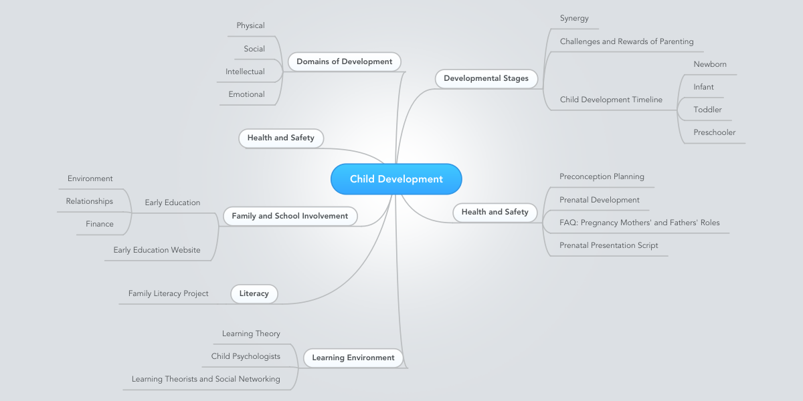
Idea generation Technique
Mind Map

Slide 4
About Mind mapping
Concept of graphical technique which connect imagination between the piece formed from idea or information.
the main purpose is to utilize it for
Taking notes,
Potential solution for problems,
Planning project,
Setting career and personal goal,
Improving your study, and
brainstorming
Add a footer

Slide 5
Main reason behind choosing mobile application
Dependent on gadgets, especially on mobile phone.
So after analysis the above mentioned problems, we have decide to choose mobile application in order to develop.

Slide 6
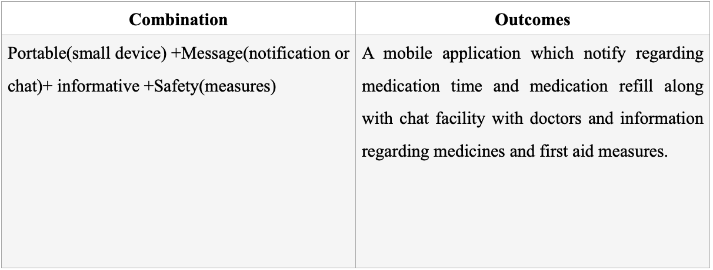

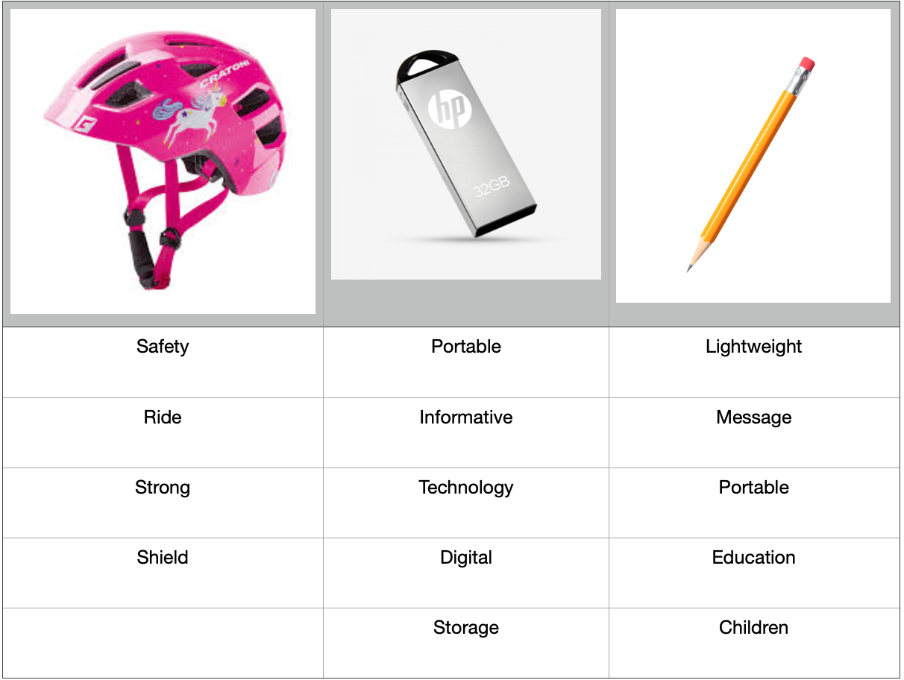

Force Fitting Trigger
Reason to choose mobile application
People are more lean towards digital technology so analysis the problem mentioned above and people loves towards technology, we have decided to develop a mobile application.

Slide 7
Competitor Analysis
Details about two competitor are mentioned:
Health is wealth
GTECH
Headquarter: New Baneshwor, Kathmandu, since 2009
Specialty: Online health service.
Available vaccine for different virus are provided.
Product Name: Onlinecheck.
Headquarter: Mahendrapool, Pokhara, since 2007 by Dr. Saujan Baskota.
Specialty: Online Services through mobile application.
Booking hospital bed while appointed suggest for hospitalized.
Product Name: healthylife.com
Add a footer

Slide 8
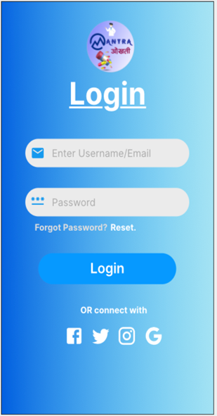
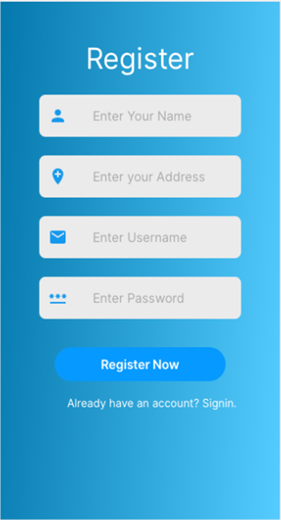
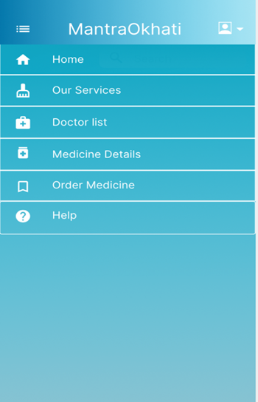
Product Description

Slide 9
Features and Functions
Features
Functions
Online Payment
Book the appointment of available doctor.
Symptoms and prescription are shown through video by related doctors.
Different languages are available to understand in easy way.
Available doctors and their schedule for taking appointment.
Payment of medicine and fee of doctors through mobile banking.
Details of medicine are described.
Virtual meeting has been conducted in order to treatment of patient’s.
Technology
Database: implementation of Mango DB
Programming languages: C++

Slide 10
Market Evaluation
the Packing and Pricing are mentioned below:
Packing
Pricing
Free packing services:
View profiles
View doctor list
Details about medicine.
Premium packing services:
Virtual meeting
Treatment
Payment
Booking of doctors schedule
Prescription
Booking bed while appointed doctor suggest you to hospitalize
Free Download
Two week is provided for free trial.
Three different subscription are available for clients:
$1.99 as monthly premium package.
$9.99 as Six month premium package.
$17.99 As Yearly Premium package.

Slide 11
Market Evaluation
the Place and promotion are mentioned below:
Place
Promotion
Application is available in kaski district at beginning.
After analyzing the download rate, future proceed will be performed all over the country
Hospital
Advertisement in social media through mobile application.

Slide 12
Idea Evaluation
(SWOT analysis)
Strength | Contact number of doctors are available, Information about disease, symptoms and prevention measures.
Weakness | Some people might difficulties in order to use it. Serious injury cannot solve through this application.
Opportunity | Use of this application might provide motivation to the next generation. Adaption of innovation technology by people is increasing day by day.
Threat | Majority of people might have problem in order to get premium package. Middle class family might have problem to afford such kind of premium package.
Add a footer

Slide 13
Idea Evaluation
Cost Benefit Analysis
Estimation development cost is $1.5 million.
to get huge benefit for this application, 1 million people have to use it which indicate the income will reach at peak point.
Add a footer

Slide 14
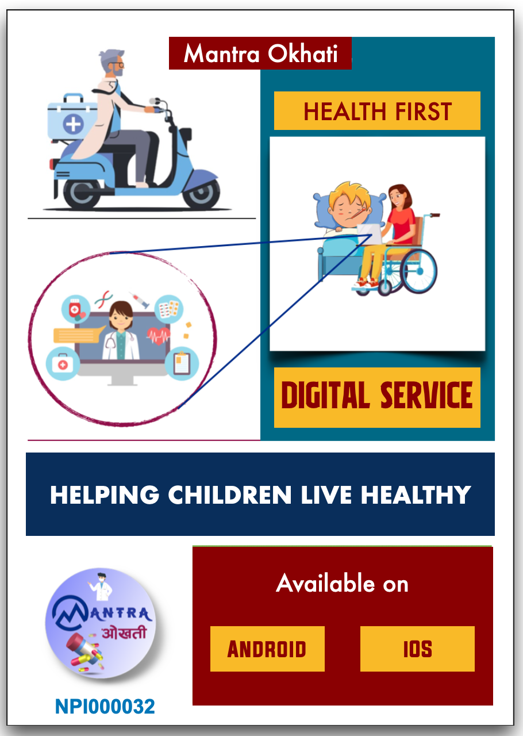
Poster

Slide 15



Competitor Analysis
Sandesh Subedi ‘A’
Divine Med
Hamro Medico
Established : 2013
Head Office : Buddha Chowk, Pokhara
Established : 2016
Head Office : New Road, Pokhara
User Interaction
Community
Barcode Scanner
Uniqueness
Uniqueness
Only available in
web version
Inaccurate
Results
Limitation
Limitation

Slide 16
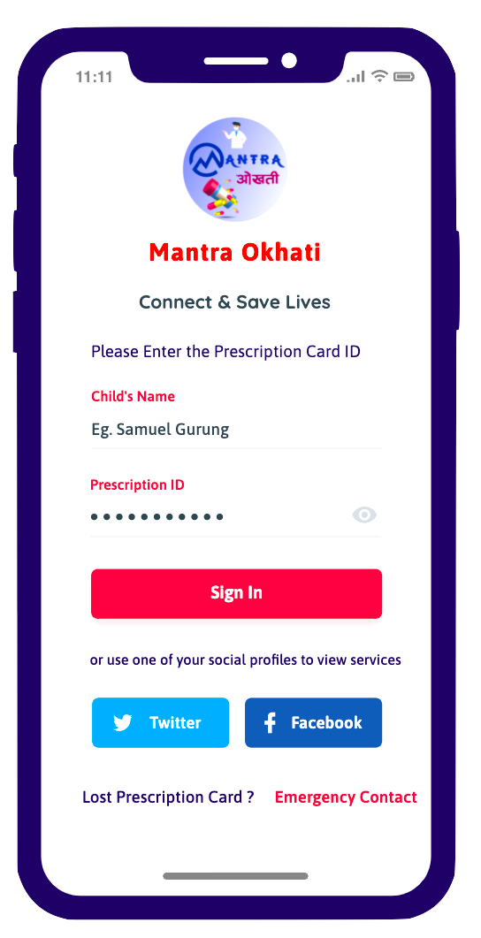
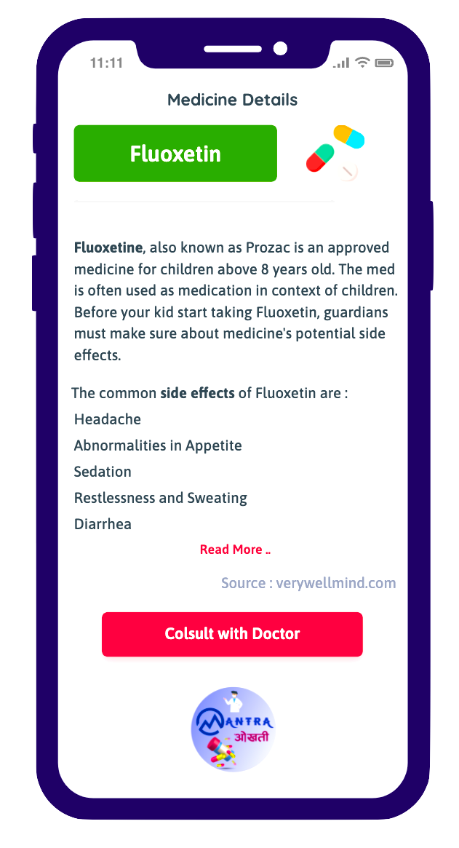

Product Features & Functions
Secured Authorization
Medicinal Supplies
Medication Information
Product Code Scanner

Slide 17
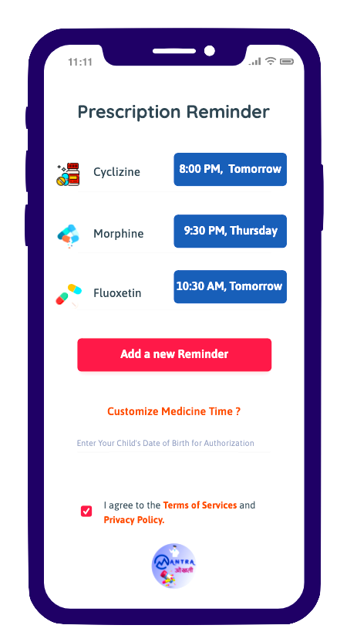
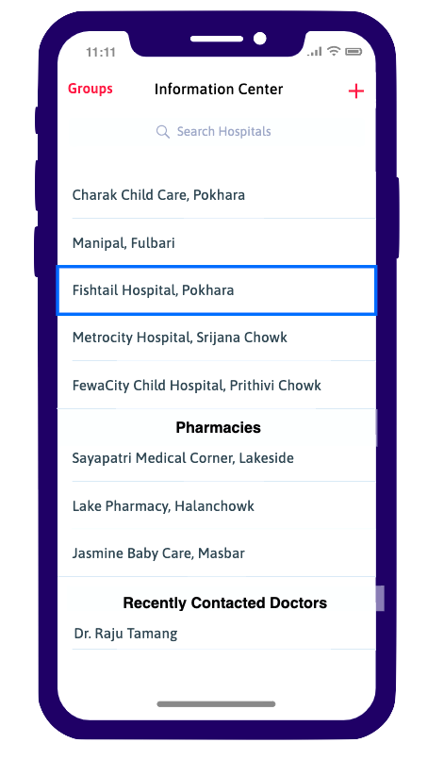
Product Features & Functions
Prescription Reminder
Video Conferencing
Nearest Pharmacies
and Hospitals
Regular Reports

Slide 18
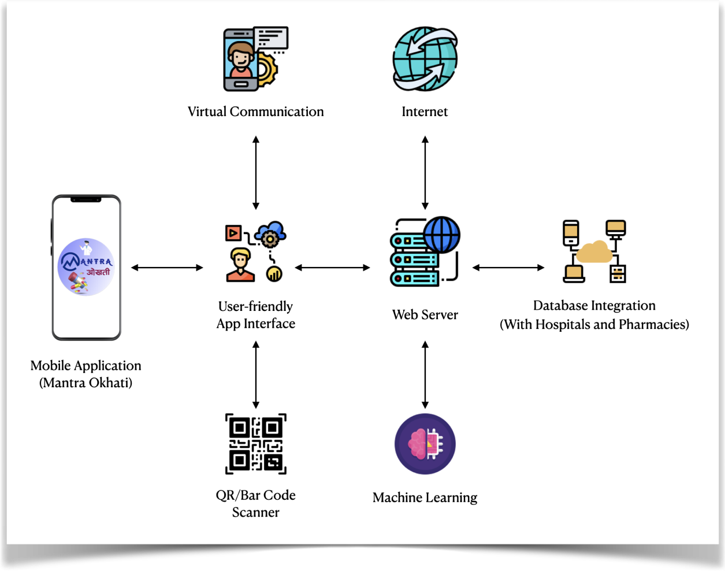

Technologies
Google Sheets
Amazon Web Services
Object Oriented Programming Concepts
Python Programming Language

Slide 19



Market Identification
1. Product
Platform Itself
2. Price
3. Promotion
4. Place
Free Download
Word-of-Mouth
Play Store (Android)
Free Trial (45 Days)
Hospitals
App Store (iOS)
Premium Packages
PHEOC
NPR 150/Month
City Hoverboards
Geographical Location
NPR 800/½Year
Online Platforms
Pokhara M. City
NPR 1500/Year
Facebook & Web

Slide 20
Idea Evaluation
SWOT Analysis
Company with motivated individuals
Strengths
Support of Provincial Health Centers
Weaknesses
Language Barriers
Business Enhancement
Opportunities
Introduction of new ideology
Threats
Carelessness from Medical Institutions

Slide 21

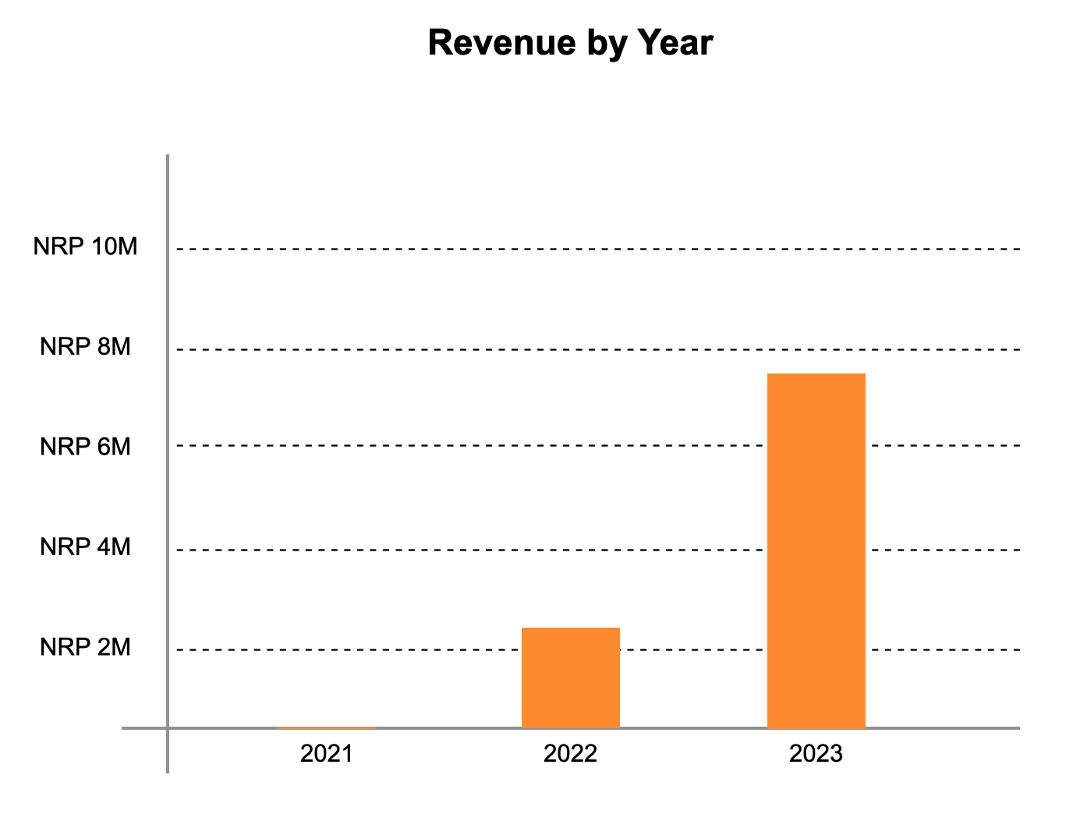
Cost-benefit Analysis
Total Cost : NPR 9,45,000

Slide 22

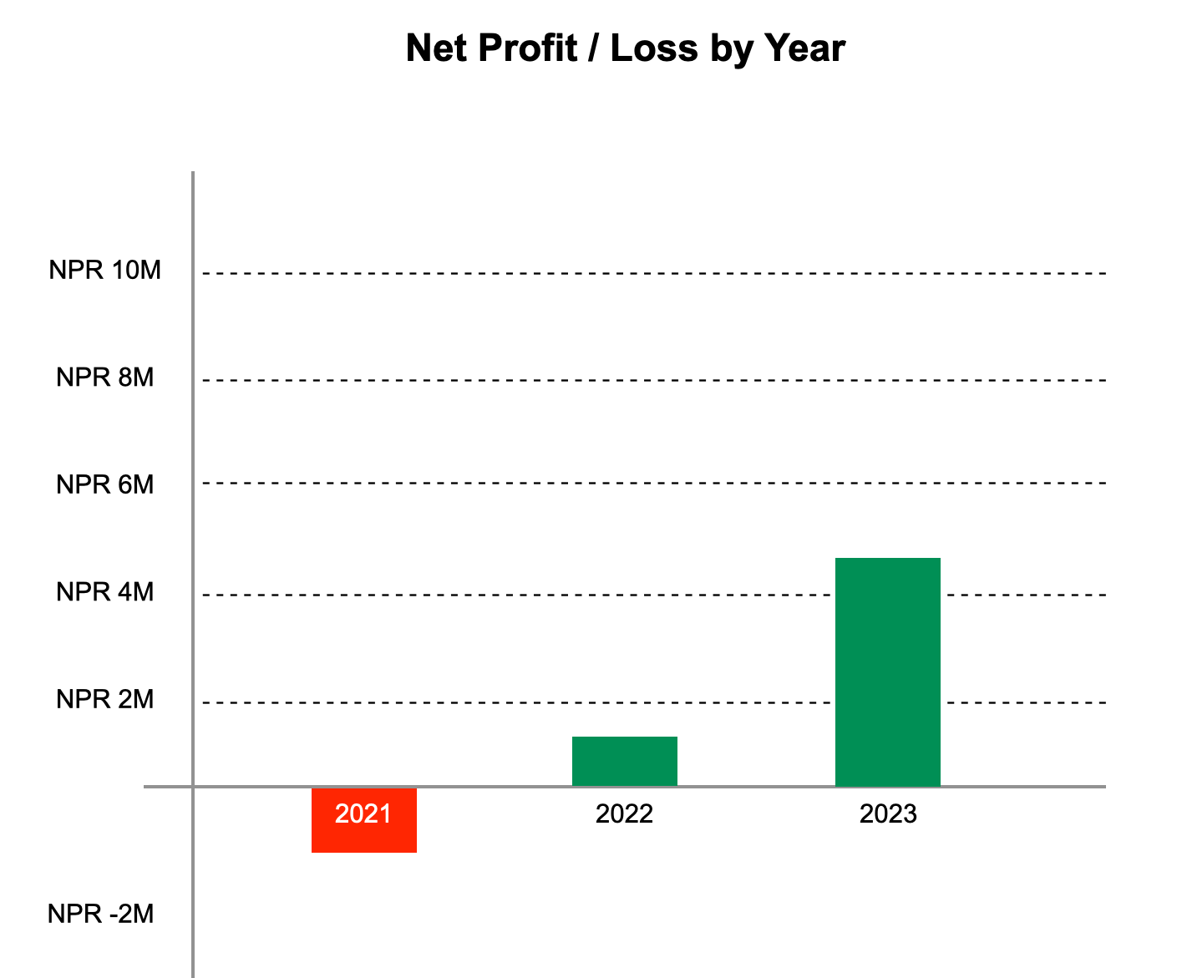

Slide 23

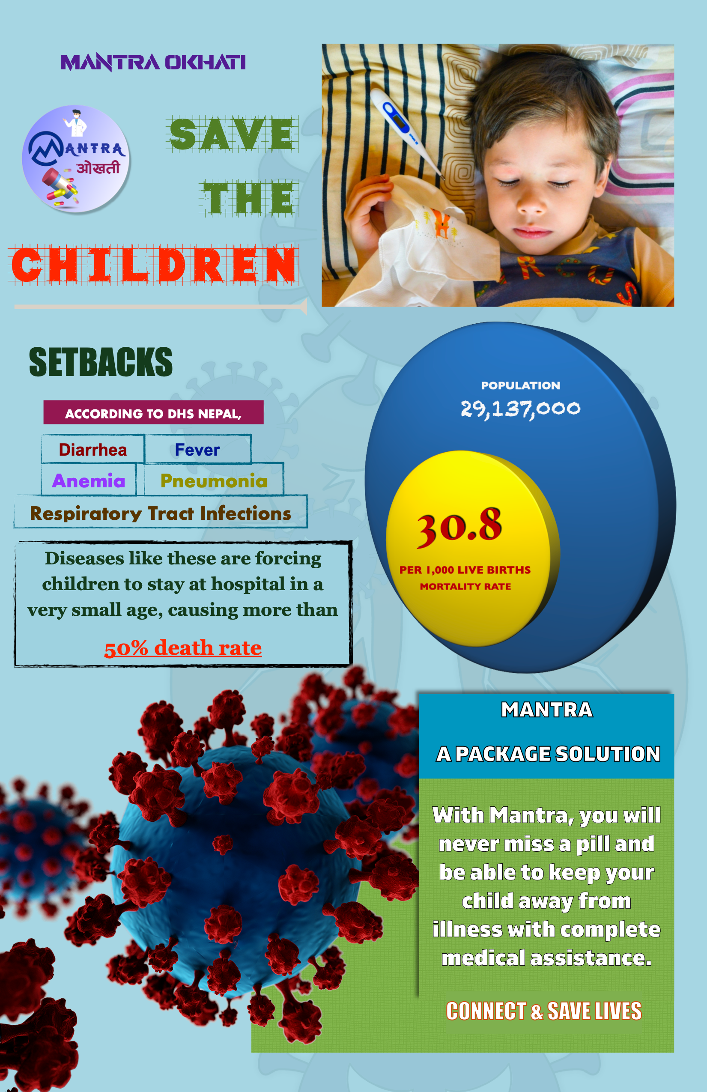
Individual Poster
Sandesh Subedi ‘A’

Slide 24
Competitor analysis
Two competitors are :
Health at Home
Established : 2007
Headquarter: Baneshwor, Kathmandu
Services through website
Services are appointment booking and counselling through phone calls, medicine delivery, nursing care at home if needed
Product is HealthAtHome website.
InfoTech
Established : 2005
Headquarter : Siddhartha chowk, Pokhara
Providing services through virtualCare application
Online appointment booking along, counselling with doctors through phone call, medicine delivery

Slide 25
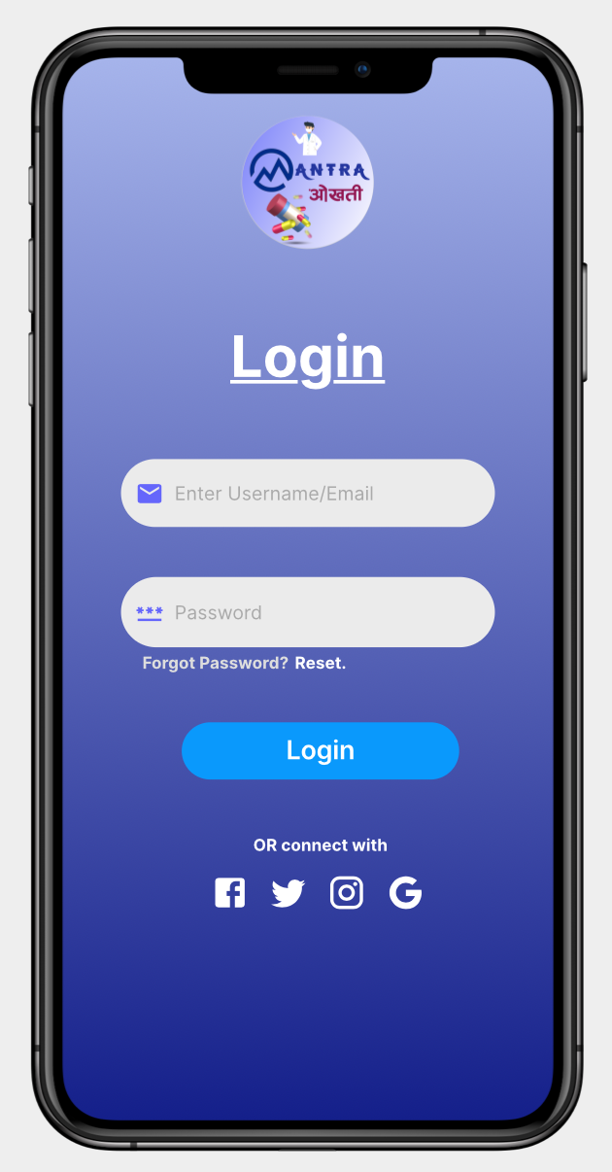
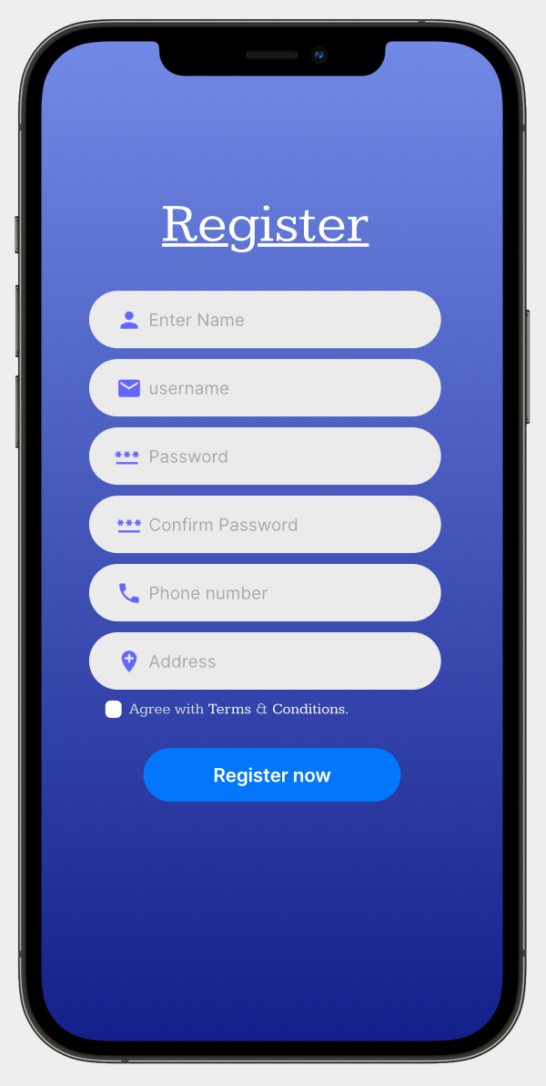
Product description

Slide 26

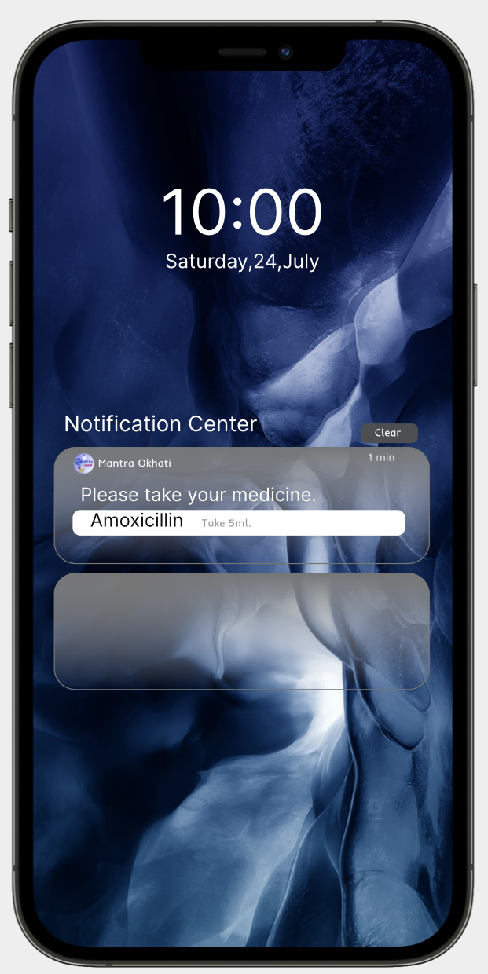
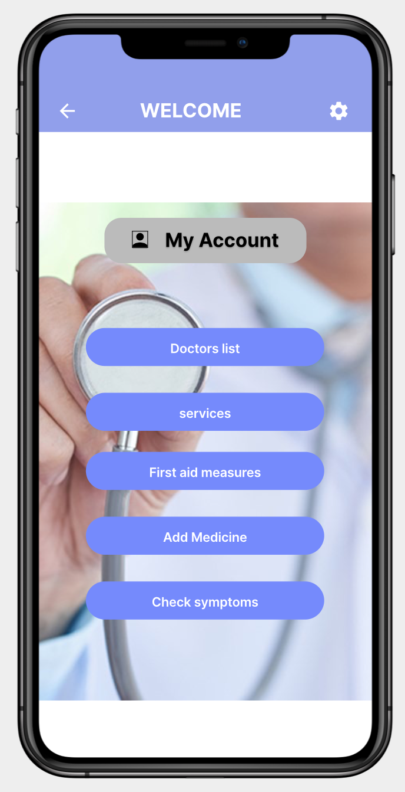
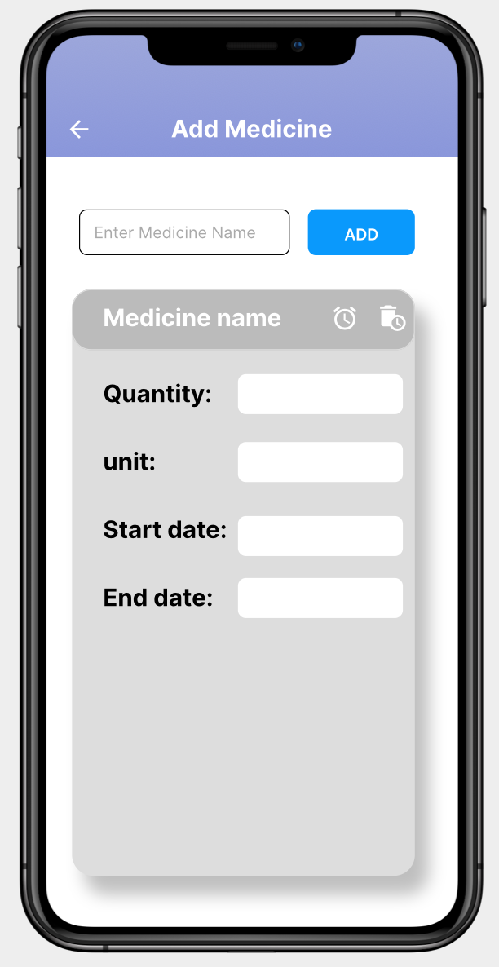
Product description Cont….

Slide 27

Features & functions
Video conferencing and telemedicine services
ePrescription (collect prescription details through online)
View and book appointment (online)
Reminder for medication time and refill
Symptoms checker
Online payment is available to pay medicine bills and doctors fees
View note of first aid measures prepared by paediatrician and experts.

Slide 28
Technology used
Database: MangoDB will be implemented (non-relational database)
Programming language : C++

Slide 29
Market Identification
Package:
Free and Premium package
Free package | Premium Package Premium package
View profile | Symptom Checker
View doctors list | Video conferencing
View First aid measures | Appointment Booking
Set medication reminder manually | Payment
 | ePrescription
 | Automatic medication and refill reminder

Slide 30

Pricing
Free to download
Free trial available for one month
Three types of subscription
Monthly premium ($1.99)
Six month premium ($9.99)
Anual premium ($17.99)
Place
First release on Pokhara valley then after recognising the download rate will be released all over the country.

Slide 31
Promotion
In social media like Facebook, instagram and YouTube
Visual advertisement infront of malls
Hospitals

Slide 32
Comparison of our product with competitors product
Features that are available in both application along with additional features such as symptoms checker, online payment, ePrescription will also be made available in this application.

Slide 33
Idea Evaluation
SWOT
Cost benefit analysis

Slide 34
SWOT analysis
Strength | Free download 24/7 service available Use of DBMS (data security is high) Available on android and IOS Simple interface
Weakness | Symptom checker might not be always accurate Must visit hospital for serious injury Need internet connection All people may not have smartphones.
Opportunity | Use of mobile phones along with adptation of new technology is increasing day by day Might usefully for people all group
Threat | People might get offend due to premium package Cost may rise due to additional features

Slide 35
Cost-benefit analysis
Suppose:
Development cost is 1 million
If only 1 million people do annual subscription in a year can earn 18 million dollar in a year which is huge amount.

Slide 36

NPI000032

Slide 37
Competitor Analysis
 | Children Health Care | Enuma Tech
i. Product Name | Children Health Application | Todo Online Medical Service
ii. Uniqueness | Won HCR award from US Department 2014, 2015. Online consultancy of doctor and paying bill. | Won awards including Parents Choice Golden Award 2015 and Google Health Application Prize 2019. Available on different languages
iii. Limitation | Only English language is available Lacks accessibility features to meet various health requirements of marginalized children. | It can be downloaded only from Play Store but not from App Store.
iv. Technology | Contains a forum where user can share their advice related to their children healthy life | Uses the database system to keep the information of medicine, doctors and hospitals

Slide 38


Product Description
Mobile based application.
Focuses on health care and decrease health problem of children mainly between 3 to 7 years old.
Users should create their account and login to use this application.

Slide 39
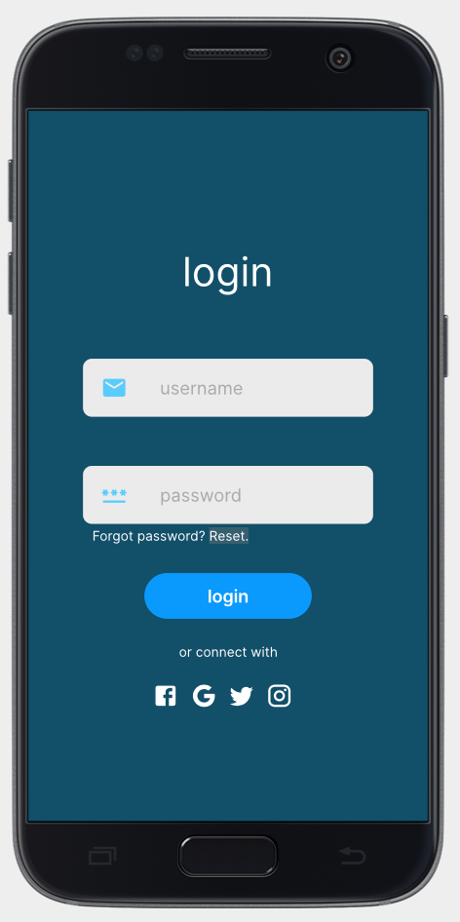
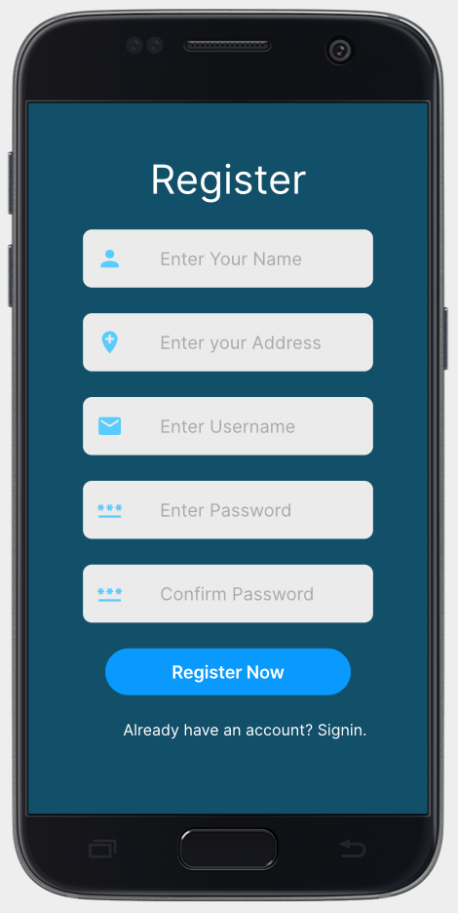
Features:
Login and register service for user:

Slide 40
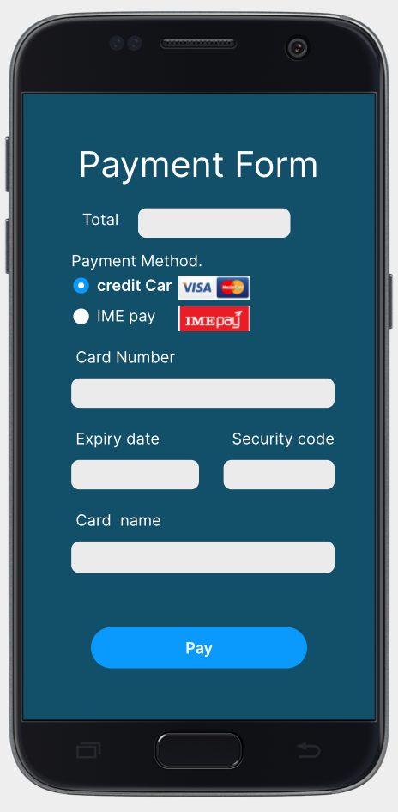
Features:
Online payment of bill and fees:

Slide 41
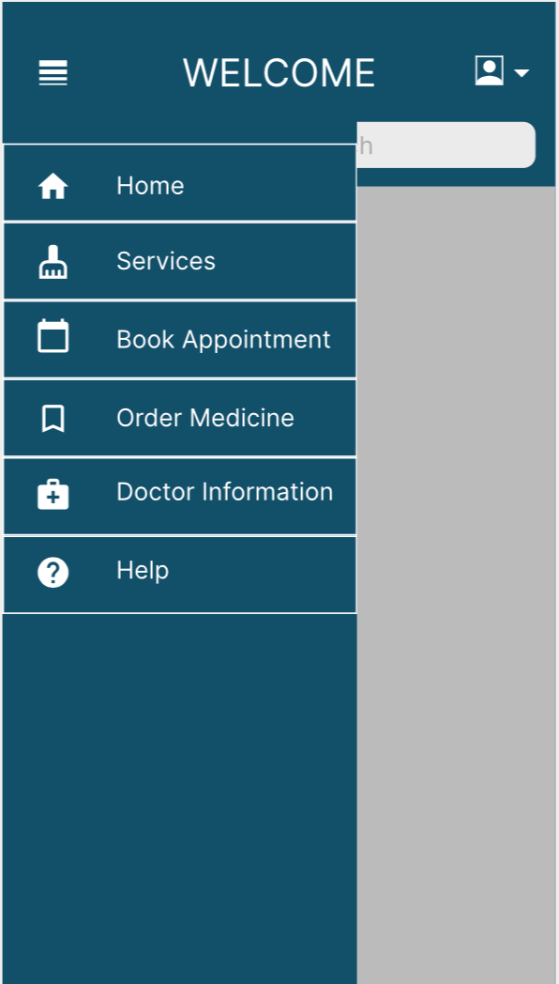
Features:
Main Menu for user:

Slide 42
Technologies:
C++ is chosen as the programming language for application.
Couch Database system to view the information of doctors, hospitals and user account.
Artificial Intelligence (AI) for chat-bot.

Slide 43
Market Identification
Package:
Free and premium package.
Price:
Monthly subscription package is $2 while yearly subscription is $20.
Place:
Will be initially launched in Pokhara valley and connect it to the hospitals, doctors and people of Pokhara.
Promotion:
Advertise from different Social Medias like Facebook, Instagram, and YouTube.
Advertise in hospitals where there are maximum number of patients.

Slide 44
Idea Evaluation
SWOT ANALYSIS:
Strength | Weakness | Opportunities | Threats
Chatbot that may answers the questions of users. | No support of multiple languages | Improves the application improvement because of lockdown. | Chance of not paying extra money for extra features.
Partnered with different hospitals of Pokhara to save the time of user. | Injury cannot be cured through an application. | Feasible co-operation with government to make it used in hospitals. | - Different Ads can upset the users.
Free to download and 1 month free trial | Internet connection is required. | Children adapting to the new technology.

Slide 45
Force Field Analysis
Force for change | Score | Force against change | Score
Maintains the health and well-being of children. | 5 | Children may addict in smartphone. | 3
Not enough other innovative product in market related to children health. | 4 | Children may feel lazy to use. | 4
User may not known the latest technology. | 4 | Premium subscription cannot be paid by normal user. | 3
Proposed idea is more relevant to targeted user. | 4 | Multiple language is not supported. | 3
Total | 17 |  | 13

Slide 46
Thank You !
END OF PRESENTATION

